Slide 1



IABC West Texas District Campus
Church Administration
Associate of Arts In Theology
Secretary of Christian Education of the AAFCJ

Slide 2


NORMS
.
Practice Confidentiality
Camera On at All Times (BRB)
Start/End on Time
Participate w/out hesitation
Respect All Comments

Slide 3

Luke 14
²⁸ For which of you, intending to build a tower, does not sit down first and count the cost, whether he has enough to finish it— ²⁹ lest, after he has laid the foundation, and is not able to finish, all who see it begin to mock him, ³⁰ saying, ‘This man began to build and was not able to finish’?
This Photo by Unknown Author is licensed under CC BY-SA-NC

Slide 4

WATERFALL
(Participation Grade)
When you think of Administrative Leadership…
In the chat, write:
Your name, the church you belong to, and the city.
Then add 3 words that come to mind when we use the title: Administrative Leadership.

Slide 5

About Administration p. 6
Church administration is the leadership which equips the church to be the church and to do the work of the church. It is the guidance provided by church leaders as they lead the church to use its spiritual, human, physical, and financial resources to move the church towards reaching its objectives and fulfilling its divine purpose.
Definition of Church Administration
Church Administration is an equipping ministry. Leadership and guidance in deploying the church’s limited resources for ministry .

Slide 6


Vision & Mission
Church Vision
Church Mission
Mission Statement sets the general direction for a given church and serves as a guide for specific programs, projects, and activities; statement that tells all who read it why the church exists and what it strives to accomplish.
A clear image of what the church is to be; a visualization of what the church will be/become.

Slide 7
Management
Building Action Plans
Identify Mission
Set Supporting SMART Goals
Create Committees to Develop Action Plan
Break the Goal down into Objectives
Assign Responsibility for Specific Action
Set a Completion Date
Estimate the Financial Impact

Slide 8

This Photo by Unknown Author is licensed under CC BY-SA

Slide 9
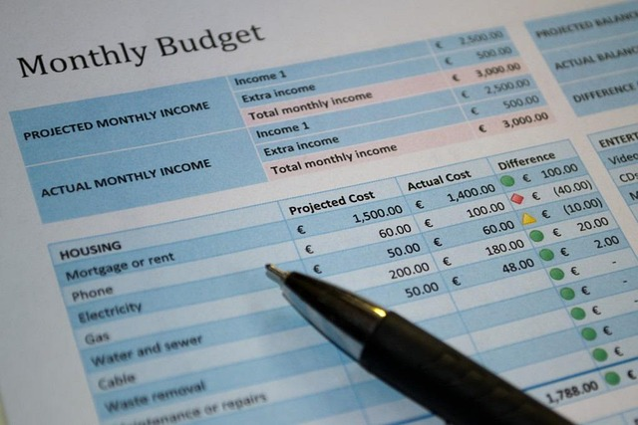
1 Corinthians 4
Let a man so consider us, as servants of Christ and stewards of the mysteries of God. ² Moreover it is required in stewards that one be found faithful.

Slide 10




Elements of Effective Church Administration
Planning
Organizing & Staffing
Leading
Assessing & Reporting
Brainstorming, thinking about the project/church, how it’s going to be done; considering the resources that will be needed.
Creating a committee or delegating assignments; considering the assignments and/or training necessary for all individuals.
Set the example. Monitoring, encouraging, redirecting – allowing others to contribute.
Gathering data – reflecting on qualitative data; and analyzing quantitative data.

Slide 11
WATERFALL
(Participation Grade)
When you think of Administrative Leadership…
Assignment (Grade)
After reading the book of Nehemiah and the first 2 chapters of the textbook, please unmute and share your reflections on the readings.
Think about:
Something that was very interesting for you – maybe something you’d never considered when going to church
Make a personal connection – how the reading applies to something in your past, or previous reading, or at your local church
Please keep your response less than 2 minutes; a minimum of 3 sentences.
In the chat, write:
Your name, the church you belong to, and the city.
Then add 3 words that come to mind when we use the title: Administrative Leadership.

Slide 12

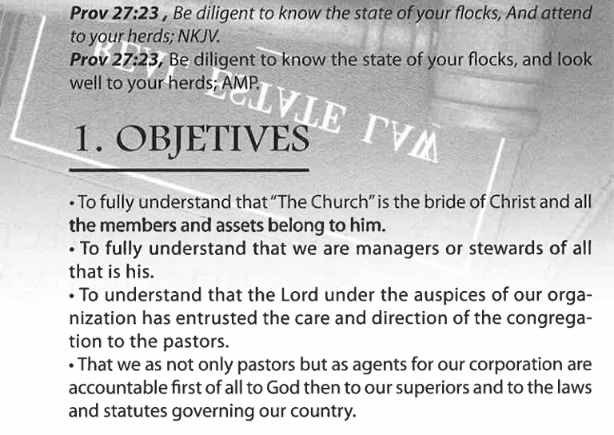
Skip to Chapter 6:
Managing the Congregation

Slide 13




Sensitivity in Managing the People of our Church
Sensitivity in the Workplace
Sexual Misconduct
Why is this important?
Mistreatment & Verbal Abuse
.

Slide 14
Abuse
Types of Abuse
Wikipedia
Abuse is the improper usage or treatment of a thing/person, often to unfairly or improperly gain benefit.
Physical
Verbal
Injury
Assault
Violation
Rape
Maltreatment
Negligence
Emotional/Psychological
Financial
Unjust Practices
Aggression

Slide 15
Types of Harassment
Quid pro quo
Hostile Environment
Any of these can be verbal, nonverbal, or physical.
This can be man to woman, woman to man, girl to girl, boy to boy, etc.

Slide 16
Hazing and/or Initiation
Illegal
Must be reported
Can be in any group of more than 2

Slide 17
Reporting is Mandatory
If you see something, say something--- to the proper authority
  Identified Leaders (like you)
  Pastor
  Minister
  Apostolic Assembly
  Authority Figure

Slide 18
Reporting is Mandatory
If you see something, say something--- to the proper authority
If someone reports it to you… do NOT ignore
  You are not authorized to determine what is/is not harassment
  Talk to the possible victim
  We are obligated to keep a safe and zero-tolerance environment
  Personal Liability & Organizational Liability

Slide 19
Reporting is Reporting is Mandatory
You do not have an option.
Information that will help (but is not necessary):
  Name of Victim
  Name of Alleged Abuser
  Address/Phone Number
  Siblings/family members
  Description of the Outcry or situation
  Is this person in immediate danger of continued abuse?

Slide 20
Reporting is Mandatory
If you see something, say something--- to the proper authority
If someone reports it to you… do NOT ignore
Respect Privacy… do not share with people who do not need to know
  Circulating rumors… now becomes harassment offense
  Ethics

Slide 21
Reporting is Mandatorytory
If you see something, say something--- to the proper authority
If someone reports it to you… do NOT ignore
Respect Privacy… do not share with people who do not need to know
Follow Up – after reporting
  Document
  Ask for Update (no need for details; just confirmation it is being addressed)

Slide 22

Liability
Organizational vs. Individual
  Tolerating
  Condoning
  Ignoring
This Photo by Unknown Author is licensed under CC BY-SA

Slide 23

Reporting Information
Your Church Leader (Praise Team, Officer, Teacher, etc.)
National Domestic Violence Hotline – 800-799-SAFE
Legal Defense Fund https://nwlc.org/legal-assistance/
Civil Rights Division (TWC) 888-452-4778
El Paso Co. Sheriff’s Non Emergency (915) 538-2292
IMPORTANT: If you don’t get assistance… keep trying. NO EXCUSES

Slide 24

Summary
No one is exempt!
Severe Repercussions
  Local Church
  Assembly
  Family
  Individual
This Photo by Unknown Author is licensed under CC BY

Slide 25


Slide 26
HOMEWORK
Jigsaw: Read two pages of the textbook and summarize into two power point slides. Please use MO ppt. (no Canva, no Google Slides, etc.)
Be prepared to share your insight and “teach” your fellow students on your reading.
Email your two slides to aprilsoliz.arioni@yahoo.com by Jan. 19, 2026

Slide 27
Name | Pages
Chavez, Isaac
Gonzalez, Anahi | 26 & 27
Martinez, Michael Caleb | 28 &29
Perez Herrera, Linda G.
Alvarado, Antonio Jr. | 30 &31
Herrera, Eloy Jr. | 32 &33
Herrera, Jason | 33 & 34
Rodriguez, Jesus | 38 & 39
Galindo, Esperanza | 40 & 41
Hernandez, Israel Alejandro
Perez Herrera, Genesis Itzel
Martinez, Matthew | 42 & 43
Matthew Garcia III
Gamon, Jacob Daniel
Ponce, Isaac
Madrigal, Rigoberto | 44 & 45
Suarez, Victor | 46 & 47
Castillo, Jorge | 52 & 53
Castillo, Julyssa | 62 & 63

Slide 28
Management
FINAL GRADE
Due Jan. 26, 2026
Create an Action Plan for a project that will meet or fill a need in your local church.
Double Space
Size 12 font
Minimum of 3 pages
No more than 5 pages
Should include:
  Proposal (Audience is your Pastor)
  Mission/Vision
  Goal(s) – each with min. of 3 objectives
  Resources (people, money, assets, etc.)
  Possible Obstacles
  Benchmarks (30 days, 60 days, etc.)
  Evalution/Reflection/Assessment

Slide 29
Part Two

Slide 30
IABC West Texas District Campus
Church Administration
Associate of Arts In Theology
Secretary of Christian Education of the AAFCJ

